Slide 1
Augmented Realty
Where Imagination Meets Reality"

Slide 2
Team 6
Team Members :
Maheshwar Punyam Anand
Ganga Prasanna
Gopi Lokindi
Pavani Karumuri

Slide 3
TABLE OF CONTENTS
What is AR
AR/VR/MR
AR Types
Advantages
Disadvantages
Examples

Slide 4

WHAT IS AR ?

Slide 5
Augmented Realty
Augmented reality is an enhanced, interactive version of a real-world environment achieved through digital visual elements, sounds, and other sensory stimuli via holographic technology.
AR incorporates three features: a combination of digital and physical worlds, interactions made in real time, and accurate 3D identification of virtual and real objects.

Slide 6
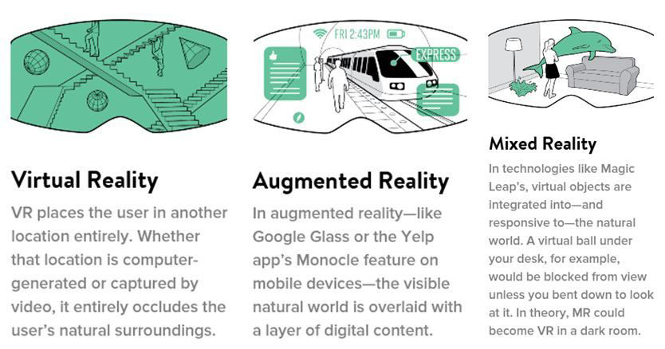
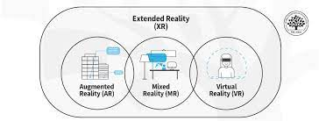
AR / VR / MR

Slide 7
AR TYPES
Based on the business requirement, we need to select the anyone of the below types.
There are two types of AR Types :
Marker-Based AR
Marker-Less AR

Slide 8
MARKER-BASED AR
Marker-based AR is created using image recognition to identify objects already programmed into your AR device or application. When placing objects in view as points of reference, they can help your AR device determine the position and orientation of the camera. This is generally achieved by switching your camera to grayscale and detecting a marker to compare that marker with all the others in its information bank. Once your device finds a match, it uses that data to mathematically determine the pose and place the AR image in the right spot.

Slide 9
MARKER-LESS AR
Marker-less AR is more complex as there’s no point in which your device will focus on. Because of this, your device must recognize items as they appear in view. Using a recognition algorithm, the device will look for colors, patterns, and similar features to determine what that object is and then, using time, accelerometer, GPS, and compass information, it will or orient itself and use a camera to overlay an image of whatever you’d like within your real-world surroundings.

Slide 10
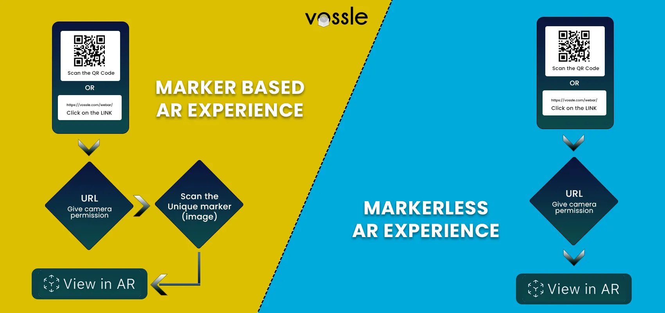
MARKER-BASED vs MARKER-LESS

Slide 11
ADVANTAGES OF AR
help enhance the learning and comprehension benefits / On-demand
Performance support
New hire onboarding
Customer service and experience
These above methods are been applied to the below mentioned sectors :
Retail
Manufacturing
Healthcare
Military
Automobile

Slide 12
DISADVANTAGES OF AR
Cost and complexity of developing and maintaining AR content
Need for compatible devices and software, and the potential for technical glitches or user errors
Bulky and expensive headsets with a limited field of view (FoV)
Security concerns when AR data is manipulated to influence worker decisions
High and expensive learning curve to use
Lack of truly precise spatial location systems for AR objects

Slide 13
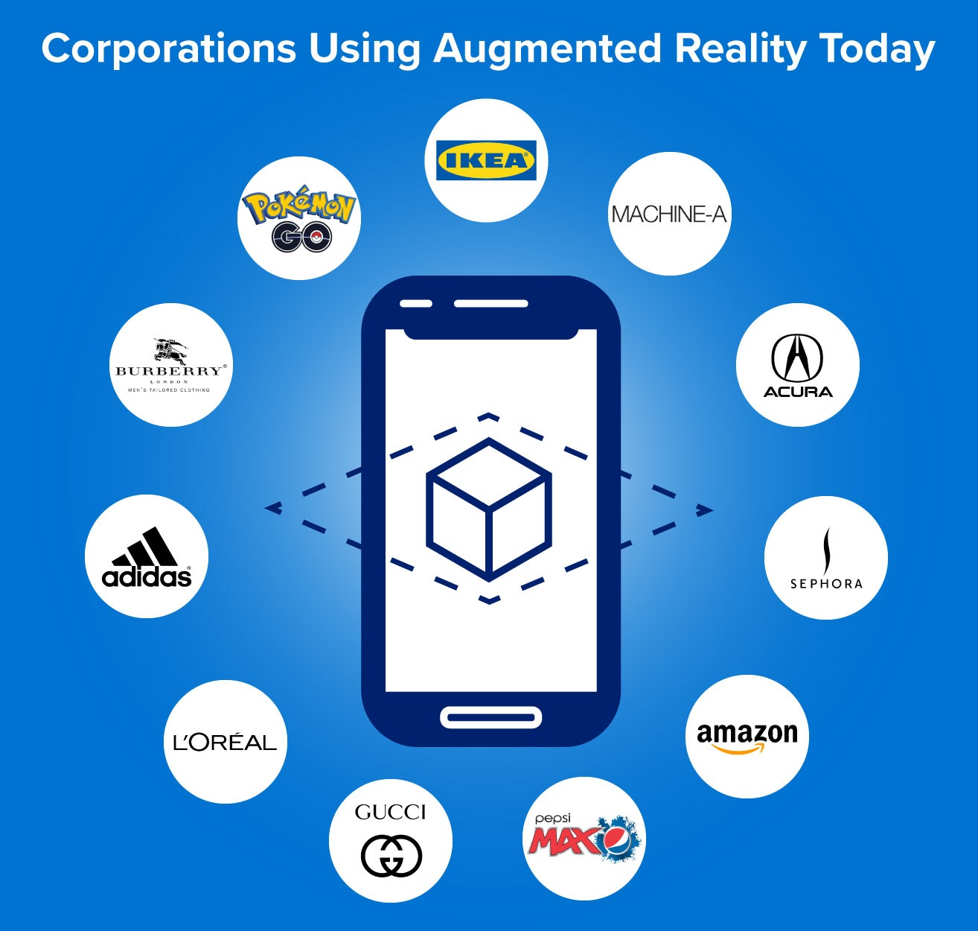

Slide 14
CONCLUSION
Potential to reshape our reality, offering exciting opportunities for innovation and improvement across various fields.
AR continues to evolve, its impact on our daily lives will become increasingly profound
Unlocking new possibilities and changing the way we interact with and perceive the world around us

Slide 15
REFERENCES
https://dynamics.microsoft.com/en-us/mixed-reality/guides/what-is-augmented-reality-ar/
https://bootcamp.cvn.columbia.edu/blog/augmented-reality
https://en.wikipedia.org/wiki/Augmented_reality

Slide 16



